Slide 1
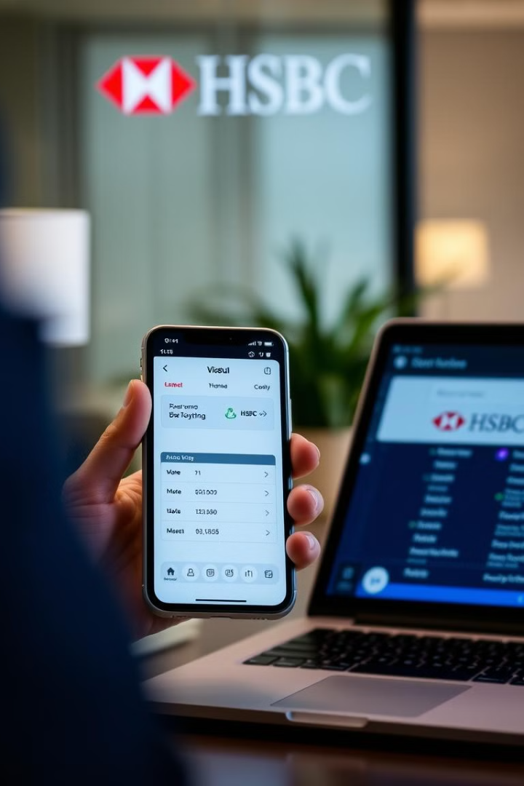
HSBC Comprehensive Digital Banking Revamp
Suneel Srikanta
Shahadat Molla
Sai Varshith Reddy
Sai Tarun Reddy
Adityaram Natakarani
Avinash Vallabhaneni

Slide 2

Project Overview
The purpose of the HSBC global digital banking platform overhaul is to transform and modernize HSBC’s digital banking infrastructure to enhance customer satisfaction, fortify security, and optimize operational efficiency. This initiative is crucial for maintaining HSBC’s position as a leader in digital banking and adapting to evolving market demands and regulatory requirements.
Project Sponsor: Global Head of Digital Banking.

Slide 3

Project Objective
Enhance Customer Experience
1
Improve UX for accessible digital banking platform to exceed
customer expectations globally.
2
Boost Security
Implement advanced security to safeguard data, transactions, and privacy, ensuring global regulatory compliance.
Ensure Compliance
3
Streamline Operations
operations to boost efficiency, reduce redundancies, and ensure smooth customer account migration without disruptions
4
Ensure Compliance
Ensure compliance with international regulations and standards throughout the project and beyond.

Slide 4
Key Problems and Opportunities
Problem:
Outdated Digital Infrastructure: The current platform is outdated, leading to a poor customer experience and inefficiencies.
Security Vulnerabilities: The platform lacks advanced security features, risking customer data and the bank’s reputation.
Operational Inefficiencies: Complex processes increase operational costs and service delays.
Opportunities:
Enhanced Customer Experience: A platform overhaul can create a more user-friendly interface, boosting satisfaction and loyalty.
Advanced Security Measures: Integrating modern security technologies can enhance protection and regulatory compliance.
Streamlined Operations: Project offers an opportunity to optimize operations, reduce redundancies, improve efficiency, and streamline account migrations.

Slide 5
Scope Statement
In-Scope
Out-of-Scope
Redesign and implementation
Physical banking infrastructure
Migration of customer accounts
New banking products or services
Integration with existing systems
Legacy systems unrelated to digital platform
Cybersecurity enhancement
Regulatory compliance
Cross Functional Collaboration
Testing and Quality Assurance

Slide 6
Deliverables
Phase 1
1
Requirements Gathering and Analysis
1
Phase 2
2
Platform Design and Architecture
Phase 3
3
Development and Testing
Phase 4
Security and Compliance
4
Phase 5
5
Data Migration
Phase 6
6
Testing
7
Phase 7
Deployment and Go-Live
Phase 8
8
Post-Launch Support and Optimization

Slide 7
Milestones
Project Kickoff
Development Phase Completion
Data Migration Completion
Deployment Readiness
Transition
Jan 2024
Aug 2024
Dec 2024
Apr 2025
June 2025
Mar 2024
Oct 2024
Feb 2025
May 2025
Design Phase
Security and Compliance Checks
Testing Phase Completion
Go-Live

Slide 8






Key Stakeholders
Global Head of Digital Banking
Project Sponsor
IT Department
Technical Implementation
Cybersecurity Team
Security Measures Implementation
Customer Representatives
User experience feedback
Legal & Compliance
Ensuring global regulatory compliance

Slide 9
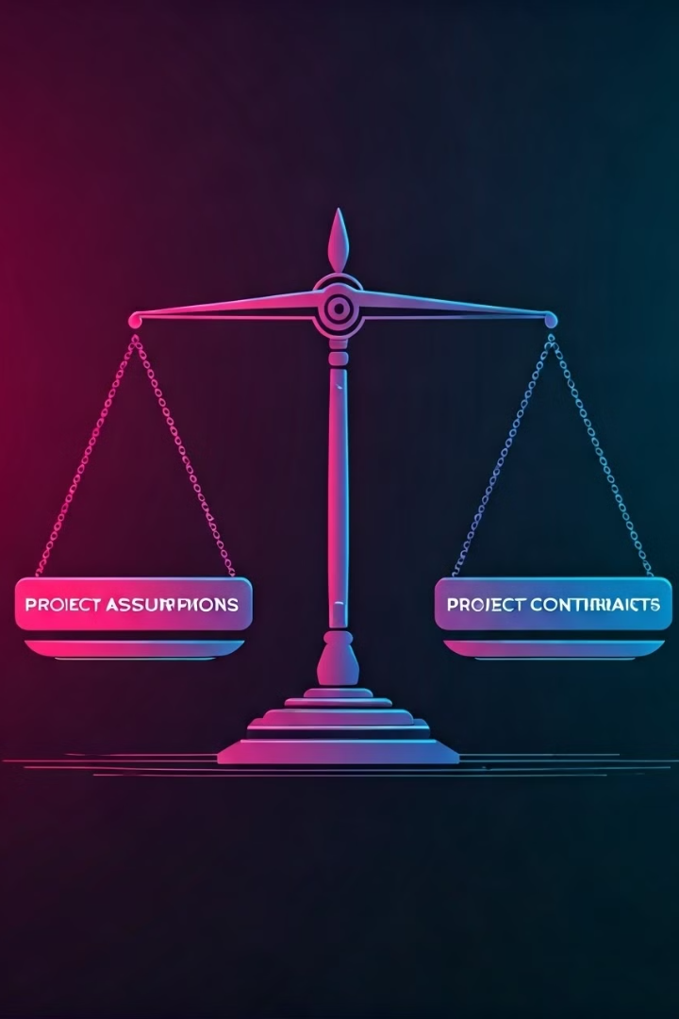
Assumptions and Constraints
Assumptions
Budget availability
infrastructure compatibility
stakeholder availability
Constraints
Timeline: Must be completed in 18 months.
Budget: $500 million.
Data Security: Must avoid service disruptions during data migration.

Slide 10




High-Level Risks and Mitigation Strategies
Data Migration Disruptions
a. Risk: Potential service interruptions or data loss during migration.
b. Mitigation:
i. Implement phased migration and extensive testing.
ii. Ensure robust backup and rollback procedures.
Regulatory Compliance Challenges
a. Risk: Difficulty meeting different regulations across regions.
b. Mitigation:
i. Set up a dedicated compliance team and consult legal experts.
ii. Regularly audit and adjust processes for all regions.
Cybersecurity Threats
a. Risk: New vulnerabilities could lead to data breaches.
b. Mitigation:
i. Use advanced security measures and regular assessments.
ii. Establish continuous monitoring and response plans.

Slide 11
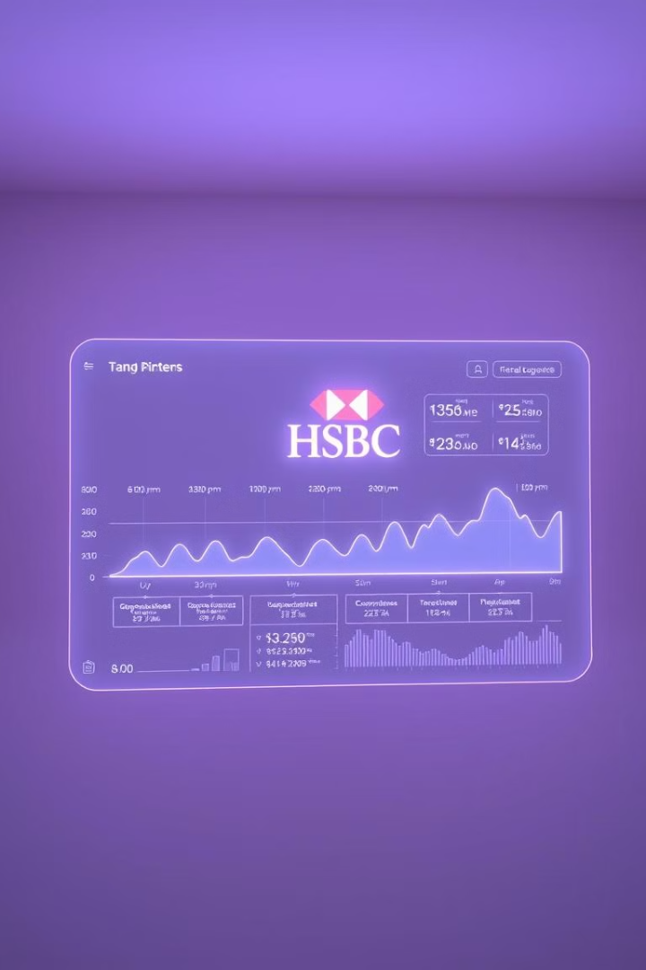
Budget and Timeline Estimates
Budget Estimates:
Planning and Analysis: $50M
Platform Development and Integration: $200M
Cybersecurity Enhancements: $75M
Data Migration and Cloud Services: $100M
Testing and Quality Assurance: $50M
Training and Change Management: $25M
Contingency and Miscellaneous: $50M
Total Budget: $500M
Timeline Estimates:
Initial Planning and Analysis: 3 months
Development and Integration: 9 months
Cybersecurity and Compliance: Ongoing
Data Migration and Cloud Setup: 3 months (overlapping with development)
Testing and Quality Assurance: 2 months
Training and Deployment: 1 month
Total Timeline: 18 months

Slide 12


Project Team and Roles
Project Manager
Oversees project activities
Technical Lead
Manages development and integration
Business Analyst
Gathers requirements
Security Specialist
Legal Advisor
Ensures compliance with global regulations

Slide 13

Kick-Off Meeting Agenda
Introduction to the project and objectives.
Overview of project scope, deliverables, and milestones.
Roles and responsibilities of the project team.
Discussion of assumptions, constraints, risks, and mitigation strategies.
Communication plan and stakeholder engagement strategy.
Q&A and alignment on next steps.

Slide 14

Stakeholder Engagement Plan
Regular project updates and status reports.
Stakeholder feedback sessions.
Regular meetings with key stakeholders
(bi-weekly updates).
Continuous alignment sessions to ensure
mutual understanding and support
Tools: Use project management software
(e.g., JIRA, Microsoft Teams) to track progress
and feedback

Slide 15

Communication Strategy
Weekly Updates
Email newsletters to stakeholders.
Monthly Status Reports
Detailed project status reports.
Post-Launch Communication
Training resources and customer support
Channels.
Town Halls
Monthly meetings Q&A on downstream
and upstream issues.

Slide 16
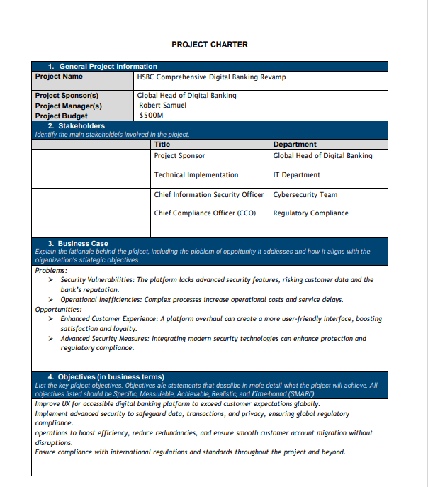
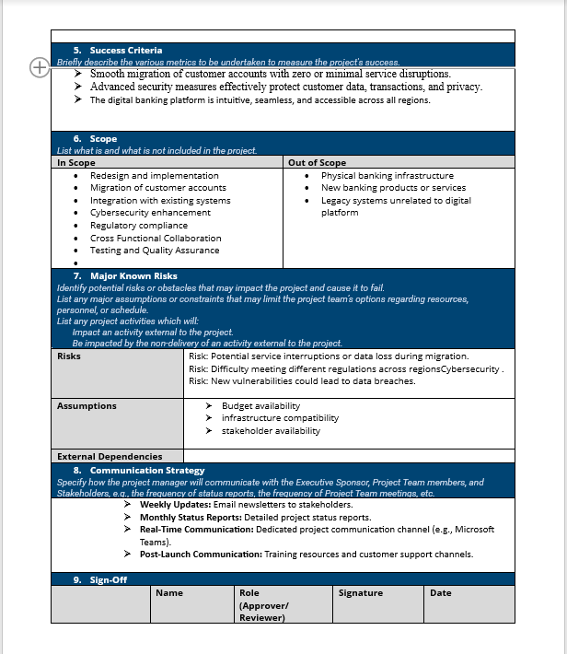

Slide 17

Q & A

Slide 18

Thank You

